Slide 1

WHO mHealth Technical Advisory Group (mTAG) on Evidence, Impact and Scale in Reproductive, Maternal, Newborn and Child Health
James BonTempo (JHU∙CCP)
Kelly L’Engle (FHI 360)

Slide 2
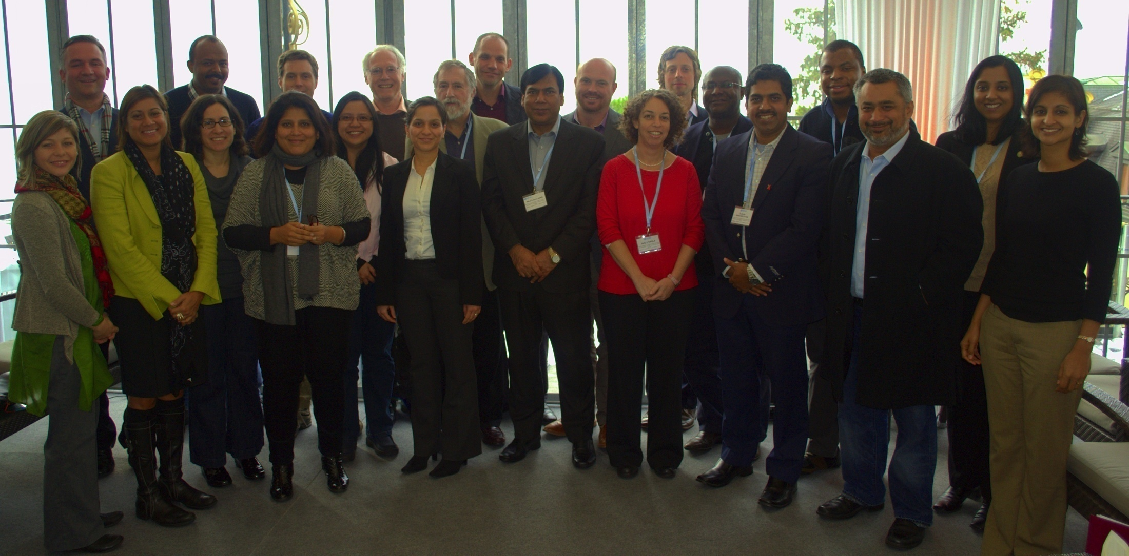
The crew
Notes:
From Dec 12 – 14 in Montreaux, Switzerland
22 health and technology implementers, developers, researchers, policy makers and donors
Establishment of the mTAG and review of preparatory white papers commissioned by WHO, produced by JHU GmI

Slide 3
Our goal
To extend WHO/RHR and partners’ continuing work in leveraging mHealth in support of UN Millennium Development Goals (MDGs), especially related to RMNCH, by establishing a WHO mHealth Technical Advisory Group (mTAG) to foster and facilitate improved evidence generation and knowledge synthesis, for the development of guidance and best practices related to the use of mHealth innovations for health systems strengthening, aimed at decision-makers and implementers.
Notes:
Synthesize evidence to develop policy guidance for mHealth for RMNCH

Slide 4
What will we facilitate?
Identifying sources of evidence
Cataloging sources based on a taxonomy
Assessing sources using standards and criteria
Synthesizing findings from sources
Recommending strategies for policy makers
Notes:
What we’ll actually do in plain language!

Slide 5
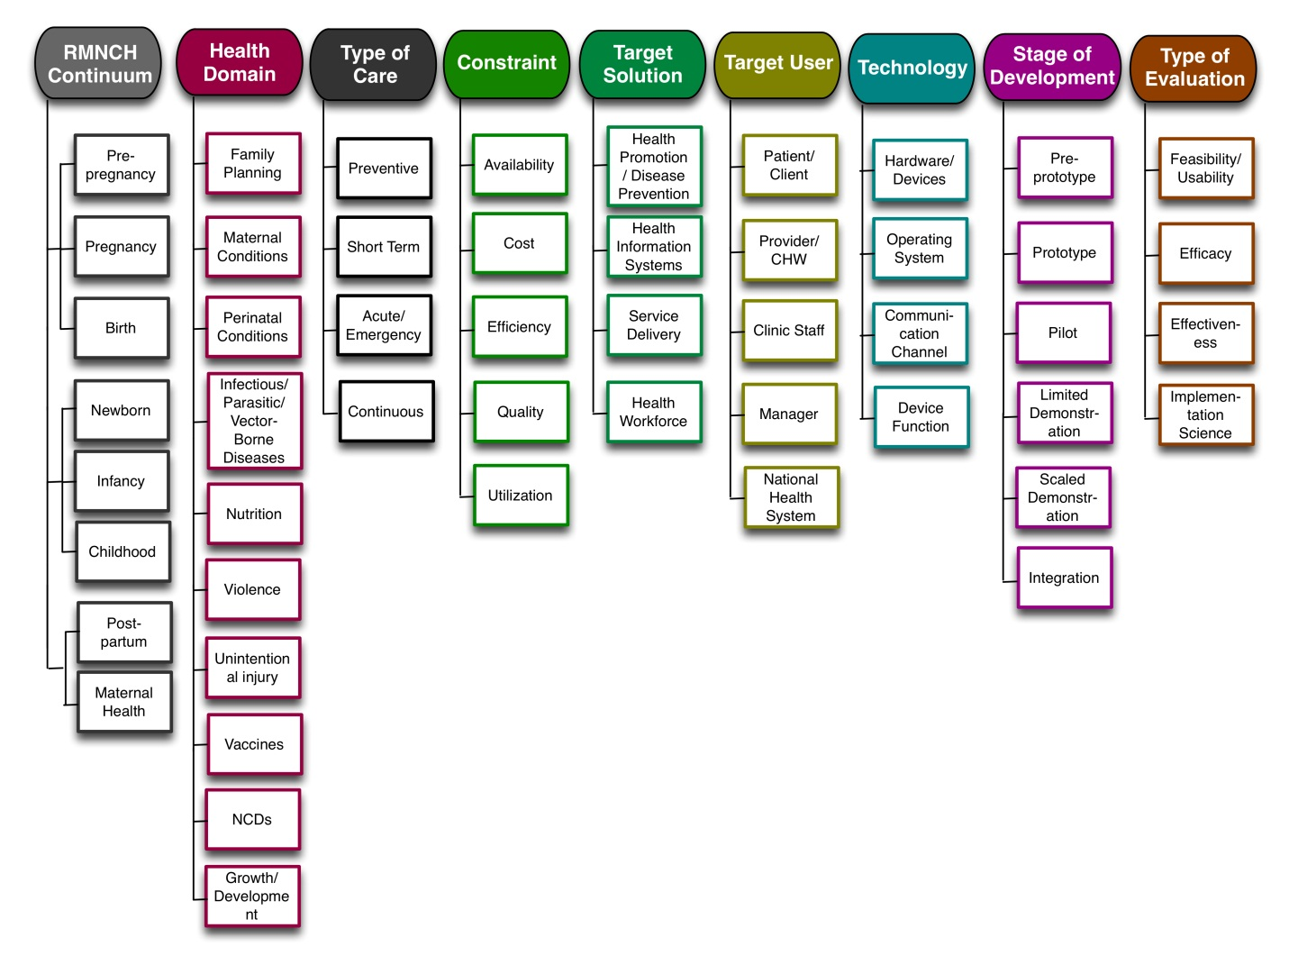
Product example: Taxonomy
Notes:
It’s important to point out this was the draft developed for the meeting but it will be further developed & refined

Slide 6
Product example: Criteria
Standard | Criteria | Points | Score | % Achieved
1. Theoretical Basis | Evidence base for mHealth strategy is cited | +1
 | Based on intervention of known efficacy | +1
 | The information reports a clear theoretical framework used to design the intervention | +1
 | Sub component score | 3
2. Technological considerations | Clearly presents the availability of infrastructure to support technology operations (eg: access to power and connectivity) | +1
 | Describes the technology architecture including the software and hardware | +1
 | Clearly describes the strengths and weaknesses of the technology | +1
 | Clearly describes the ability of different user groups to successfully use the technology in a given context (Usability/feasibility) | +1
 | Sub component score | 4
3. Problem Focused | mHealth solution states one or more constraints in the delivery of current service, intervention, process, or product | +1
 | Sub component score | 1
 | Total | 8 | /8
Notes:
Like the taxonomy, it’s important to point out this was the draft developed for the meeting but it will be further developed & refined

Slide 7
Task forces/Working groups
NAME | CHAIRPERSON
Evidence Needs | Marc Mitchell
Vocabulary & Taxonomy | James BonTempo
Indicators | Alain Labrique
Assessment Criteria | Kelly L’Engle
Synthesis | TBD
Stakeholder Engagement | Chaitali Sinha
Logistics | Garrett Mehl
Strategic Dissemination | Nandini Oomman
Governance/Operations | Garrett Mehl
Notes:
Task forces will continue work & produce tangible products in collaboration w/other experts and groups (e.g., mHA EWG)

Slide 8
POINT/COUNTERPOINT!

